Slide 1
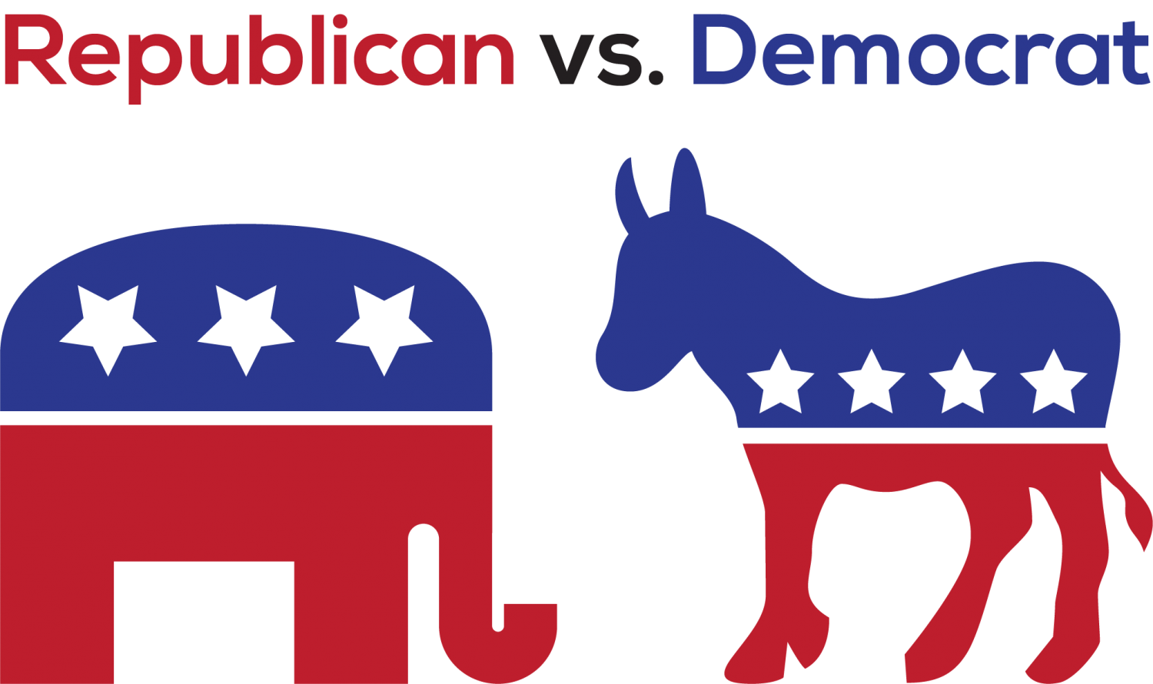
Community and Key Player Detection in 116th Meeting of US Congress
Tony Liu Ran (G1902349D) ~ Chin Kiat Boon (G1902005G)
Ju Chuang (G1901896K) ~ Pua Ming Xiu (G1902258C)

Slide 2

Overview
Data Description, Background and Problem Statement
Exploratory Data Analysis
Dataset to Multigraph with Weighted Edges
Community Detection Using Louvain
unfiltered and specific policy areas
Finding Key Players using Evaluation Metrics
Conclusion

Slide 3
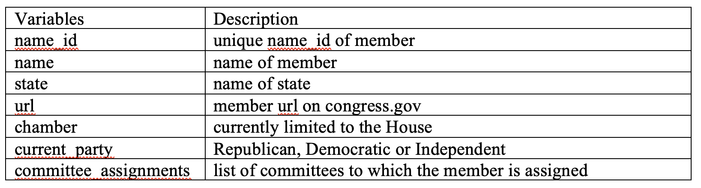
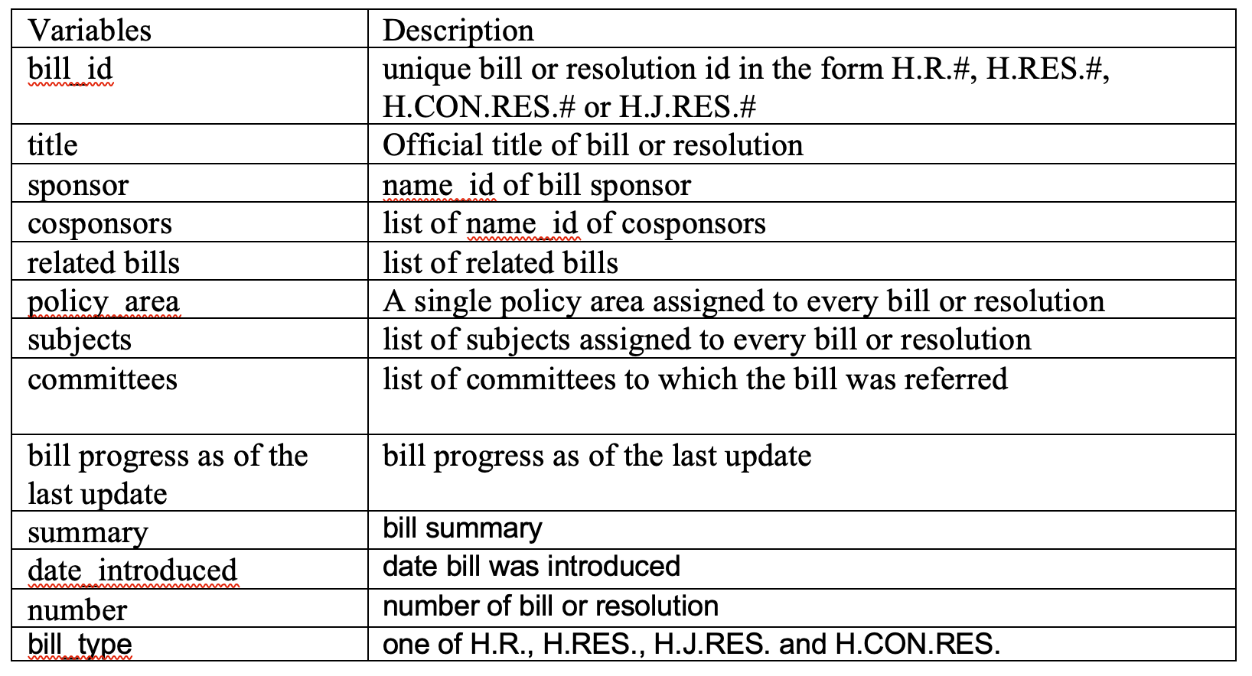

Data Set Description
Members Dataset
Bills Dataset
information related to members of the 116th House of Representatives
information related to bills and resolutions introduced in the 116th House of Representatives

Slide 4
Background
The 116th meeting of United States Congress convened on 1/3/19 and will end 1/3/2021.
Legislators can make public their support for a particular bill by cosponsoring it in the US Congress.
Differences in philosophy between the 2 parties (Republicans vs Democrats) on myriad policy areas, may lead to different communities in the Congressional networks
Conservative
individual freedoms
rights and responsibilities
Liberal
Equality and social/community responsibility.

Slide 5

Problem Statement
Given the philosophical differences between the Democrats and Republicans, collaborative behaviour of the Members of Congress are expected to be found in communities.
Our project therefore aims to detect the community and key player to better understand the collaborative behavior of the Members of Congress.

Slide 6
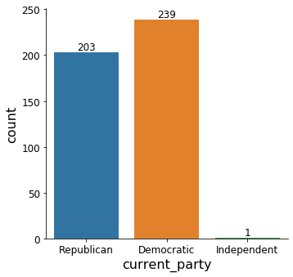

Data Exploration
Number of Members by Current Party
Majority of the House of Representatives are Democrats

Slide 7
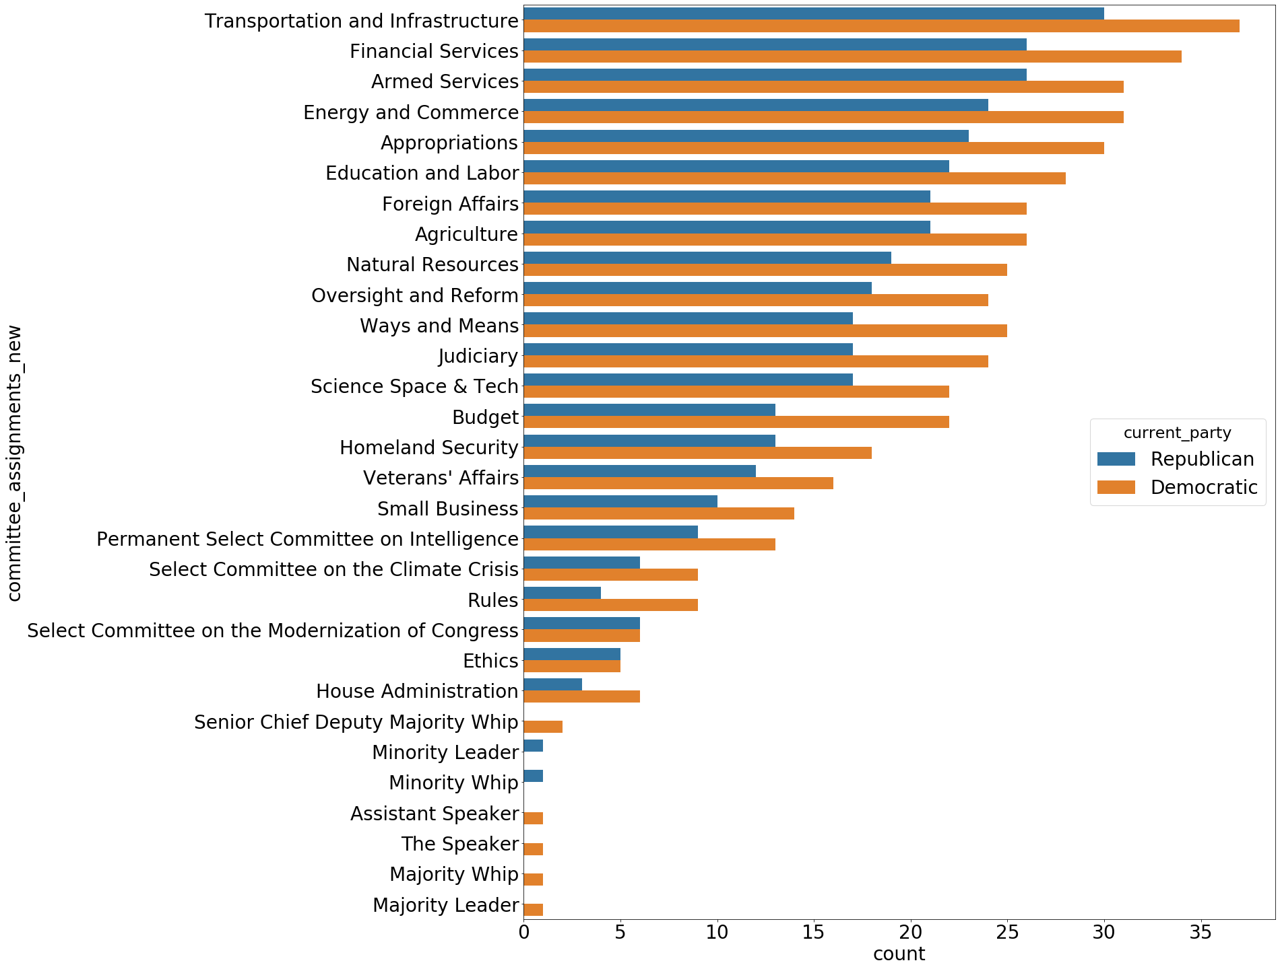
Data Exploration
Top 5 committee assignments
Members by Committee Assignment
Republican and Democratic parties are fairly distributed in terms of their committee assignments.

Slide 8
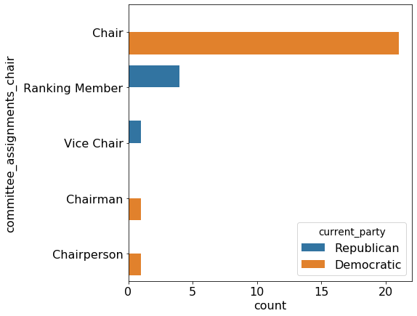
Data Exploration
Committee Leaders by Policy Area and Party Type
Being the majority party, the Democratic are to select the Committee Chairs and Republican as the minority party will select the Ranking Members to lead them.

Slide 9
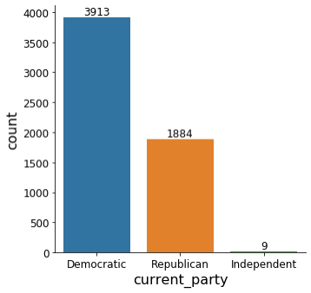
Data Exploration
Bills by Current Party of Sponsor
Bills under the Sponsorship of Democratics (67.4%) were more than twice than that of the Republicans (32.4%). This is in line with legislative control of Democrats in the House of Representatives.

Slide 10
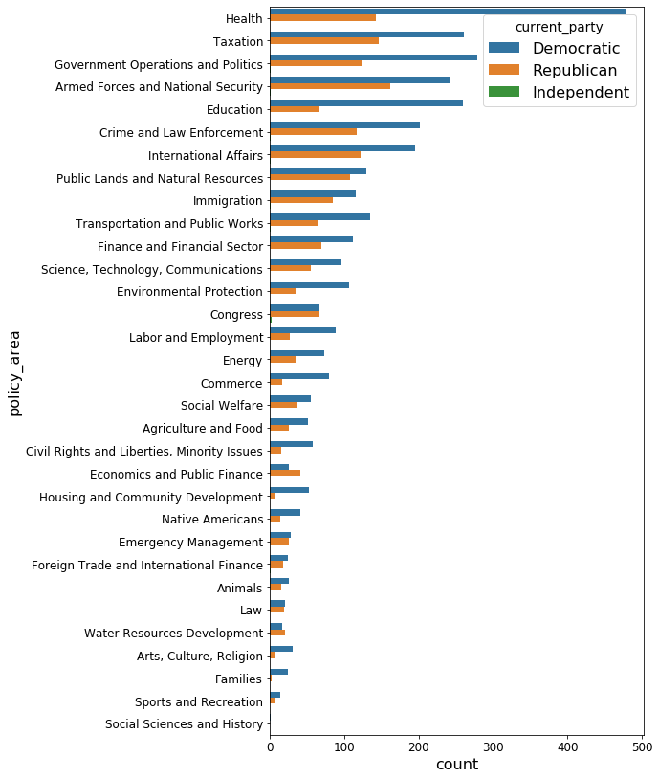
Top 5 Policy Areas
Data Exploration
Majority of the bills introduced were under the sponsorship of Democrats in most of the policy areas.
In areas such as Congress, Economic & Public Finance and Water Resources Development, there are more bills under the sponsorship of Republicans than Democrats.
Bills Introduced by Policy Area and Current Party of Sponsor

Slide 11
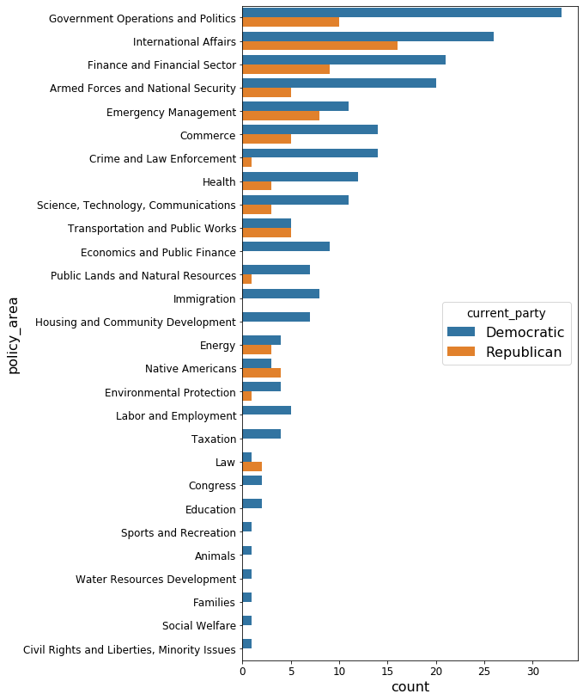
Top 5 Policy Areas
Data Exploration
Low pass through rates of bills that were introduced
Philosophical differences in the two parties
Some degree of polarisation in political behaviours among members of the same party? (i.e. liberal Republicans and conservative Democrats)
Despite Republicans having more bills introduced in the policy areas of Congress, Economic & Public Finance and Water Resources Development than Democrats, there were no bills passed under the sponsorship of the Republicans in these policy areas!!
Bills Passed by Policy Area and Current Party of Sponsor

Slide 12
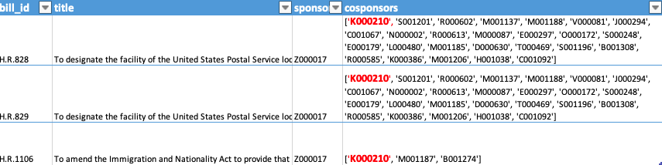



Preprocessing
H.R.828
3 X
H.R.829
Sponsor
Z000017
H.R.1106
Co-Sponsor
K000210

Slide 13
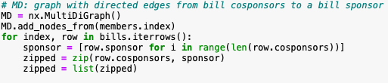
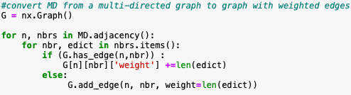
Multi-Directed Graph
Weighted Edges Graph
H.R.828
H.R.829
Sponsor
Z000017
Co-Sponsor
K000210
H.R.1106
Weightage of 3
Sponsor
Z000017
Co-Sponsor
K000210

Slide 14
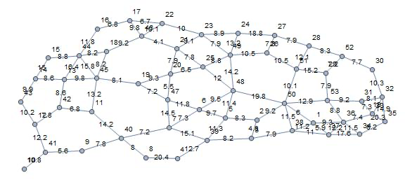
Weighted Edges Graph
Sponsors and Cosponsors who tend to support each other's bills are more densely connected.
Hint: History of Democrats & Republicans

Slide 15
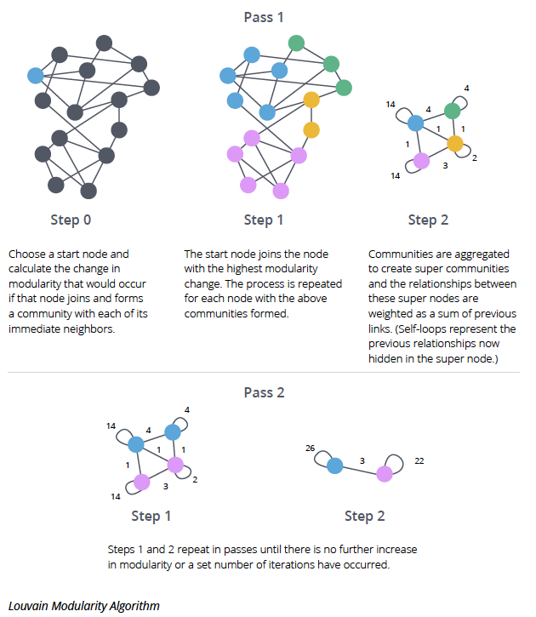
Louvain Modularity Algorithm

Slide 16
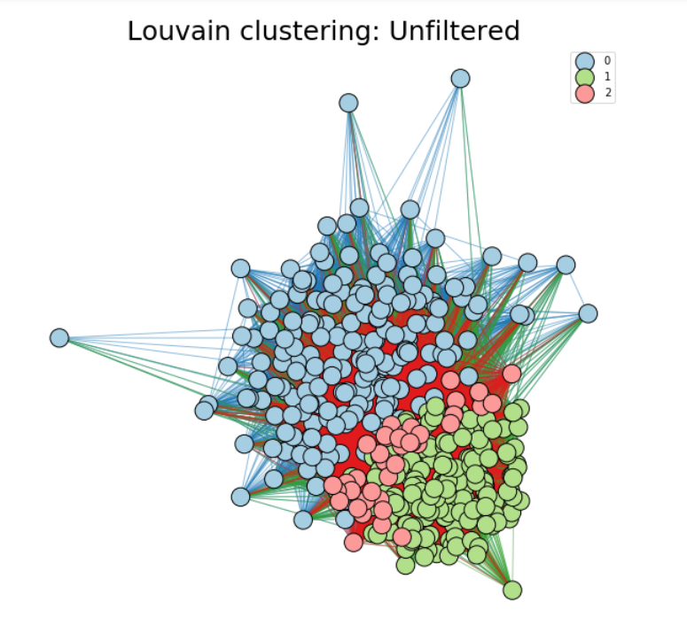
Community Detection by Louvain Clustering
#use louvain community detection algorithm to detect communities in G and store the nodes in different groups separately in communities
communities =[ ]
louvain = community.best_partition(G, weight = 'weight', random_state=42)
for i in set(louvain.values()):
nodelist = [n for n in G.nodes if (louvain[n]==i)]
communities.append(nodelist)
Detect the communities by Louvain Clustering
The results show that there are 3 communities
Visualize the communities for better understanding
Draw the network by package ‘network’
Blue colour is group 0, green colour is group 1 and red colour is group2
We can see that the red nodes (community 2) are mixed with green nodes (community 1)

Slide 17
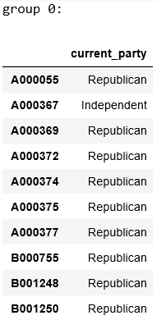
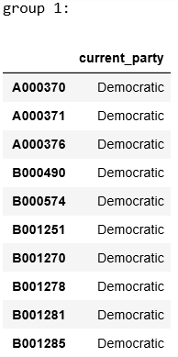
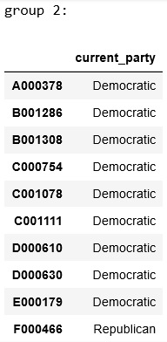
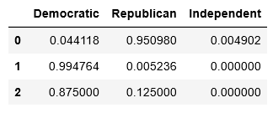
Findings for Community Detection
Nodes from community 2 are mixed with those from community 1 because most of them both from Democratic party
There are two factions inside Democratic party
Nodes from community 0 are mainly from Republican party
Community detection is not bad and can clearly differentiate different parties

Slide 18
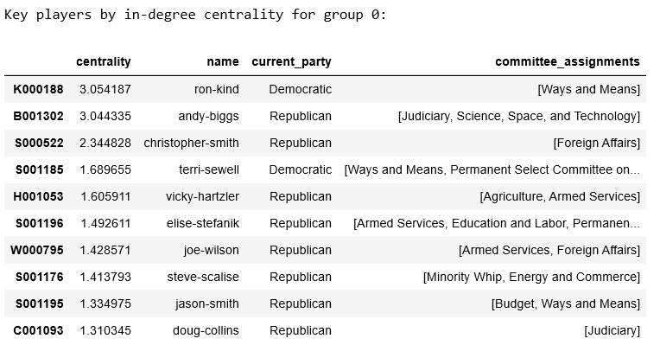
Key Players Detection By in-degree Centrality
#set community_of_interest
community_of_interest =0
#create subgraph with nodes limited to the community_of_interest
subgraph0 = MD.subgraph(communities[community_of_interest])
#sort members of community_of_interest by in_degreee centrality
pd.DataFrame.from_dict(nx.algorithms.centrality.in_degree_centrality(subgraph0), orient = 'index', columns = ['centrality']).merge(members[['name','current_party’, 'committee_assignments']],
how = 'outer', left_index = True, right_index = True).sort_values(by= 'centrality',ascending = False).head(10)
Select the interested community
Create the subgraph with nodes in the community
Calculate the in-degree centrality by the network package and save in column ‘centrality’
Sort the data frame based on the centrality
The top ranked people are the key players
What is interesting, in the top 5 key players in community 0, there are two people from Democratic party. This may indicate vested interests or hidden political motives or they may be undercovers.

Slide 19
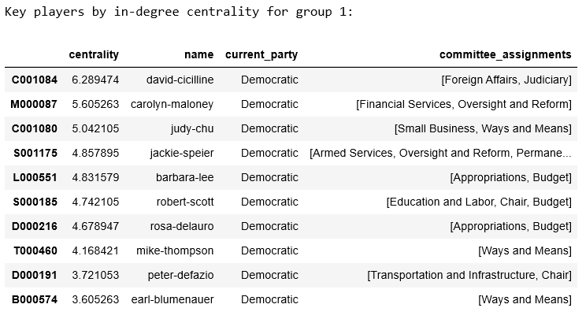
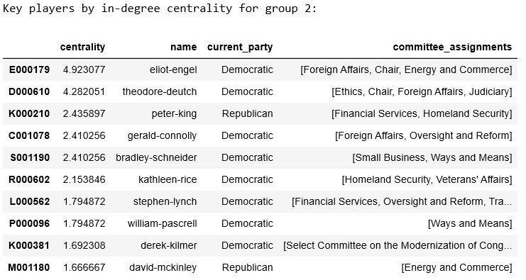
Key Players Detection by in-degree Centrality
Followings are the output for community 1 and 2
From community 2 we can find that it seems Democratic party also planted a undercover in Republican party

Slide 20
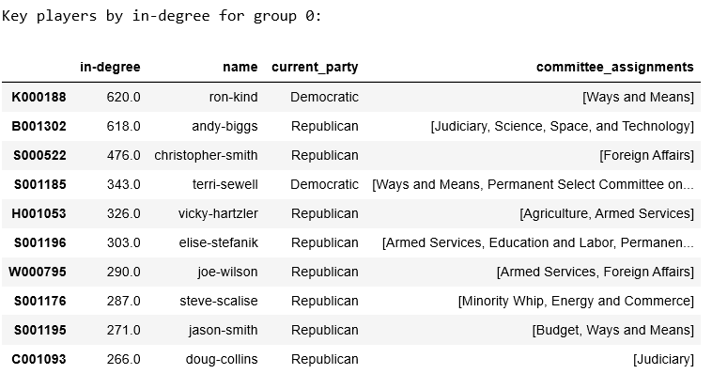
Key Players Detection by in-degree
# key players using degree for community 0
sortdeg = sorted(subgraph0.in_degree, key=lambda x: x[1], reverse=True)
deg =pd.DataFrame(sortdeg).rename(columns={1: “in-degree"})
deg.set_index(0, inplace=True)
deg.merge(members[['name','current_party', 'committee_assignments']], how = 'outer', left_index = True, right_index = True).sort_values(by= ‘in-degree',ascending = False).head(10)
Take community 0 as an example
Create the subgraph with nodes in the community 0
Calculate the in-degree and save in column ‘in-degree’
Sort the data frame based on the degree
The top ranked people are the key players
The top 5 key players are same as previous based on in-degree centrality due to similar technique

Slide 21
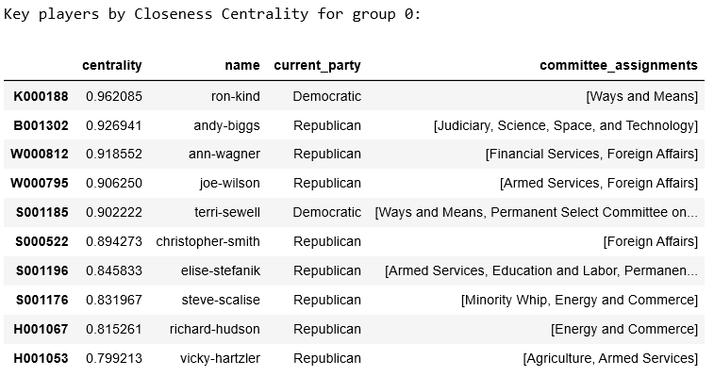
Key Players Detection by Closeness Centrality
pd.DataFrame.from_dict(nx.closeness_centrality(subgraph0), orient = 'index', columns = ['centrality']).merge(members[['name','current_party',
'committee_assignments']], how = 'outer', left_index = True, right_index = True).sort_values(by= 'centrality',ascending = False).head(10)
Closeness Centrality:
The reciprocal of the sum of the length of the shortest paths between the node and all other nodes in the graph (Normalized)
The more central a node is, the closer it is to all other nodes
Take community 0 as an example
Create the subgraph with nodes in the community 0
Calculate the Closeness Centrality and save in column ‘centrality’
Sort the data frame based on the CC
The top ranked people are the key players

Slide 22
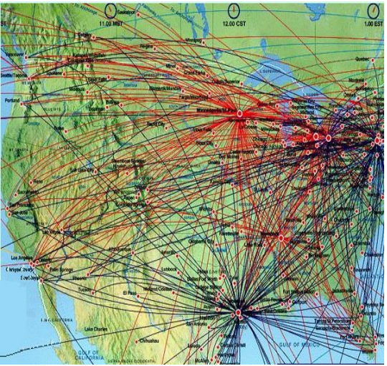
Key Players Detection by Closeness Centrality
We can find that 3 people in the top 5 key players by in-degree also in the top 5 key players by closeness centrality

Slide 23
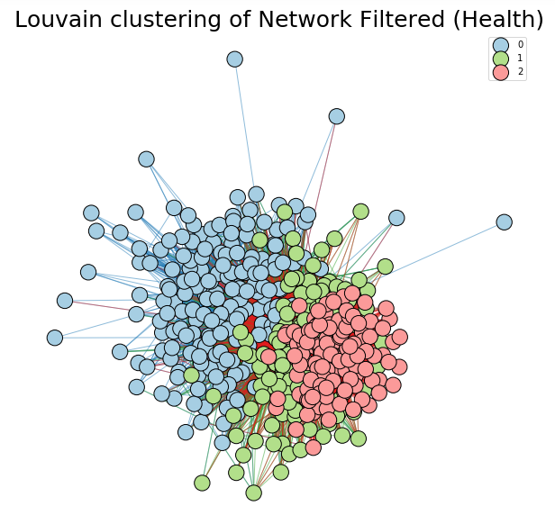
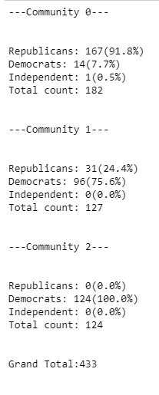
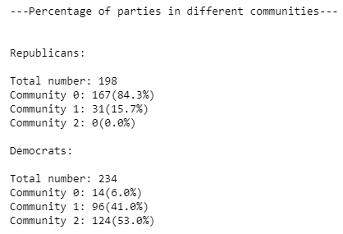
Community Detection for Policy Area (Health)
Within each party:
Republicans largely in community 0
Democrats split between community 1 and 2
Across different parties:
Community 0: Most consist of republicans (with some democrats)
Community 1: ¾ are democrats
Community 2: All democrats, no republicans

Slide 24
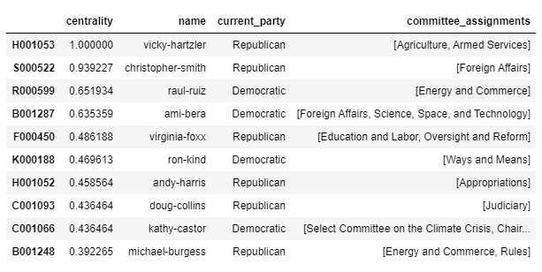
Key Player Detection for Policy Area (Health)
Findings (eg Group 0)
Similar to earlier findings (Key players similar in both methods)
Even though community 0 is republican-dominant (91.8%), 2 democrats are key players
Possible reasons
Fake democrats? (as suggested earlier)
Are the democrats divided amongst themselves?

Slide 25
Summary
Multi-Directional Graph
Weighted Edges Graph
Community Detection
Key Influencers

